Slide 1


ENGINEERING CAPSTONE PROJECT – 1/INDUSTRIAL INTERNSHIP/ INDUSTRIAL INTERNSHIP PHASE-I
Project Review-1
Project Title
Enterprise Role-Based Access Control & Identity Auditor
Team No-16
2320030047-P.Varun Reddy
2320030410-K.Chandana
2320030446-Pardhava Nandan
Under the Guidance of
Dr K.Swanthana
Assistant Professor
Department of Computer Science and Engineering
KONERU LAKSHMAIAH EDUCATION FOUNDATION

Slide 2
OUTLINE
Introduction
Problem Statement
Objectives
Literature Survey
Research Gap Identification
Innovation, Creativity, and Novelty
Feasibility and Project Plan

Slide 3
Introduction
• Enterprise systems contain many users, applications, roles and permissions.
• RBAC simplifies authorization by assigning permissions to roles and roles to users.
• Over time, employees may change departments or responsibilities, creating privilege creep and stale access.
• An Identity Auditor continuously analyzes identities, role assignments and permissions to detect excessive or unused access.
• The proposed system combines RBAC administration with automated auditing, least-privilege recommendations and explainable reports.
• Application: enterprise applications, HR/finance systems, cloud services and internal platforms.

Slide 4
Problem Statement
Enterprise users may accumulate unnecessary permissions when their roles or responsibilities change, causing privilege creep and increasing security risks. Traditional RBAC systems may not continuously monitor or identify excessive, unused, or conflicting permissions
The proposed Enterprise Role-Based Access Control & Identity Auditor manages users, roles, and permissions while auditing access activities. It helps detect excessive privileges, enforce least-privilege access, and improve enterprise identity security.

Slide 5
Objectives
Phase 1 – Requirement Analysis & System Design
Identify enterprise RBAC and identity-auditing requirements.
Define users, roles, permissions, resources, and access policies.
Phase 2 – Identity & RBAC Management
Implement user and role management.
Create role-permission and user-role mappings.
Phase 3 – Identity & Permission Auditing
Audit user accounts, roles, and assigned permissions.
Detect excessive, unused, duplicate, and conflicting permissions.
Phase 4 – Risk Analysis & Violation Detection
Develop an access-risk scoring mechanism.
Detect privilege creep and potential privilege escalation.
Phase 5 – Intelligent Recommendations
Generate least-privilege recommendations.
Suggest removal or modification of unnecessary permissions.
Phase 6 – Dashboard, Reporting & Evaluation
Develop an interactive RBAC & Identity Audit Dashboard.
Display users, roles, permissions, risks, and violations.

Slide 6
Literature Survey
No. | Year | Research Paper | Model / Framework | Major Outcome | Limitations / What Your Project Can Address
1 | 2020 | Managing Constraints in Role Based Access Control | Constrained Role Mining | Improves RBAC role generation by considering organizational constraints. | Does not continuously audit identities or detect privilege creep.
2 | 2020 | An Incremental Algorithm for the Role Mining Problem | Incremental Role Mining | Updates roles efficiently when user-permission assignments change. | Focuses on role updates; does not identify unused or excessive privileges.
3 | 2020 | An Accurate and Scalable Role Mining Algorithm Based on Graph Embedding and Unsupervised Feature Learning | Graph-based Role Mining | Improves role-mining accuracy and scalability using graph learning. | Does not provide continuous identity auditing or risk-based authorization.
4 | 2021 | A Scalable Role Mining Approach for Large Organizations | Scalable Role Mining | Generates suitable roles for large organizations using machine-learning-based role mining. | Mainly addresses role generation, not ongoing privilege monitoring.
5 | 2022 | Role Mining Heuristics for Permission-Role-Usage Cardinality Constraints | Constraint-Based RBAC | Produces usable roles while controlling role and permission cardinality. | Does not monitor whether users actually need their assigned privileges.
6 | 2023 | Role Mining under User-Distribution Cardinality Constraint | Constraint-Based Role Mining | Controls the number of users assigned to individual roles. | Does not detect privilege creep or provide least-privilege recommendations.

Slide 7
No. | Year | Research Paper | Model / Framework | Major Outcome | Limitations / What Your Project Can Address
7 | 2023 | An Improved Minimal Noise Role Mining Algorithm Based on Role Interpretability | Minimal-Noise Role Mining | Improves role quality and interpretability while handling noisy permissions. | Focuses on role construction rather than continuous identity auditing.
8 | 2023 | Dynamic Optimization of Role Concepts for Role-Based Access Control Using Evolutionary Algorithms | Dynamic Role Mining | Considers changing business requirements and dynamically updates role concepts. | Does not combine dynamic role management with user-risk analysis and auditing.
9 | 2023 | Hamming Distance Approach to Reduce Role Mining Scalability | Hamming Distance Role Mining | Reduces the scale of role-mining datasets and improves scalability. | Does not provide enterprise identity monitoring or privilege-risk assessment.
10 | 2025 | IRMAOC: An Interpretable Role Mining Algorithm Based on Overlapping Clustering | Interpretable Role Mining | Generates more understandable roles using overlapping clustering and improves role interpretability. | Does not provide continuous auditing, privilege-creep detection, or access-risk scoring.
11 | 2025 | Bi-objective Optimization in Role Mining | Multi-objective Role Mining | Optimizes role count and authorization discrepancies simultaneously. | Does not integrate identity auditing, risk-based authorization, and least-privilege recommendations.
12 | 2025 | Studies on Survival Strategies to Protect Expert Knowledge in Evolutionary Algorithms for Interactive Role Mining | Interactive Evolutionary Role Mining | Uses expert knowledge to improve role-mining optimization. | Requires expert interaction and does not provide automated enterprise identity auditing.

Slide 8
Research Gap Identification
S. No. | Existing Research / Approach | Identified Limitation / Gap | Proposed Solution in Enterprise RBAC & Identity Auditor
1 | Traditional RBAC Frameworks | Focus mainly on predefined role and permission assignment; limited continuous detection of excessive access. | Automated RBAC auditing to analyze users, roles, and permissions and identify excessive privileges.
2 | Role Mining Techniques | Focus on generating or optimizing roles, with limited continuous identity and permission auditing. | Combine role analysis with continuous identity auditing to detect inappropriate role assignments.
3 | Constraint-Based RBAC | Organizational constraints help role generation but may not detect privilege creep or unused permissions. | Privilege analysis and least-privilege recommendations based on user-role-permission relationships.
4 | Machine-Learning-Based Role Mining | Improves role discovery and scalability but generally lacks enterprise access-risk scoring. | Introduce risk scoring to classify users, roles, and permissions according to access risk.
5 | Dynamic Role Management | Adapts roles to changing requirements but may not continuously verify whether existing access remains appropriate. | Continuous access reviews that flag outdated, excessive, or conflicting permissions.

Slide 9
S. No. | Existing Research / Approach | Identified Limitation / Gap | Proposed Solution in Enterprise RBAC & Identity Auditor
6 | Manual Identity & Access Auditing | Manual reviews are time-consuming, error-prone, and difficult to scale for large organizations. | Centralized automated audit dashboard for identities, roles, permissions, violations, and reports.
7 | Privilege Management Systems | Often focus on granting/revoking privileges with limited detection of orphaned or dormant accounts. | Detect inactive and orphaned accounts and recommend access removal or review.
8 | Access Policy-Based Systems | Static policies can become outdated when employees change departments or responsibilities. | Policy-violation detection with updated access recommendations based on current responsibilities.
9 | Existing IAM Solutions | Provide authentication and authorization but may lack detailed RBAC auditing and explainable recommendations. | Integrate identity management, RBAC auditing, risk assessment, and recommendations in one platform.
10 | Periodic Access Reviews | Fixed review cycles can miss security issues that occur between review periods. | Continuous RBAC and identity monitoring with alerts for high-risk access.

Slide 10
Innovation
• Automated Privilege-Creep Detection
• Risk-Based Access Control
• Explainable Access Decisions
• Continuous Identity Auditing
• Least-Privilege Recommendations

Slide 11
Creativity
Automated Identity Auditing – Continuously analyzes users, roles, and permissions.
Risk-Based Access Scoring – Identifies high-risk users and privileges.
Privilege Creep Detection – Detects unnecessary and excessive permissions.
Smart Recommendations – Suggests least-privilege access changes.
Interactive Dashboard – Provides real-time security insights and audit reports.

Slide 12
Novelty
The novelty of the Enterprise Role-Based Access Control & Identity Auditor is the integration of RBAC, real-time identity auditing, privilege-creep detection, risk-aware permission management, explainable access decisions, and automated least-privilege enforcement into a single system. This helps organizations continuously monitor identities and permissions while reducing unnecessary and risky access.

Slide 13
Feasibility
Frontend: React.js, Tailwind CSS
Backend: Python, FastAPI
Database: PostgreSQL / MongoDB
RBAC Engine: Roles, Users & Permissions
Audit Engine: Access & Privilege Analysis
Risk Engine: Risk Scoring & Anomaly Detection
Dashboard: Recharts / Chart.js
Security: JWT, OAuth 2.0, Encryption
Deployment: Docker, AWS

Slide 14
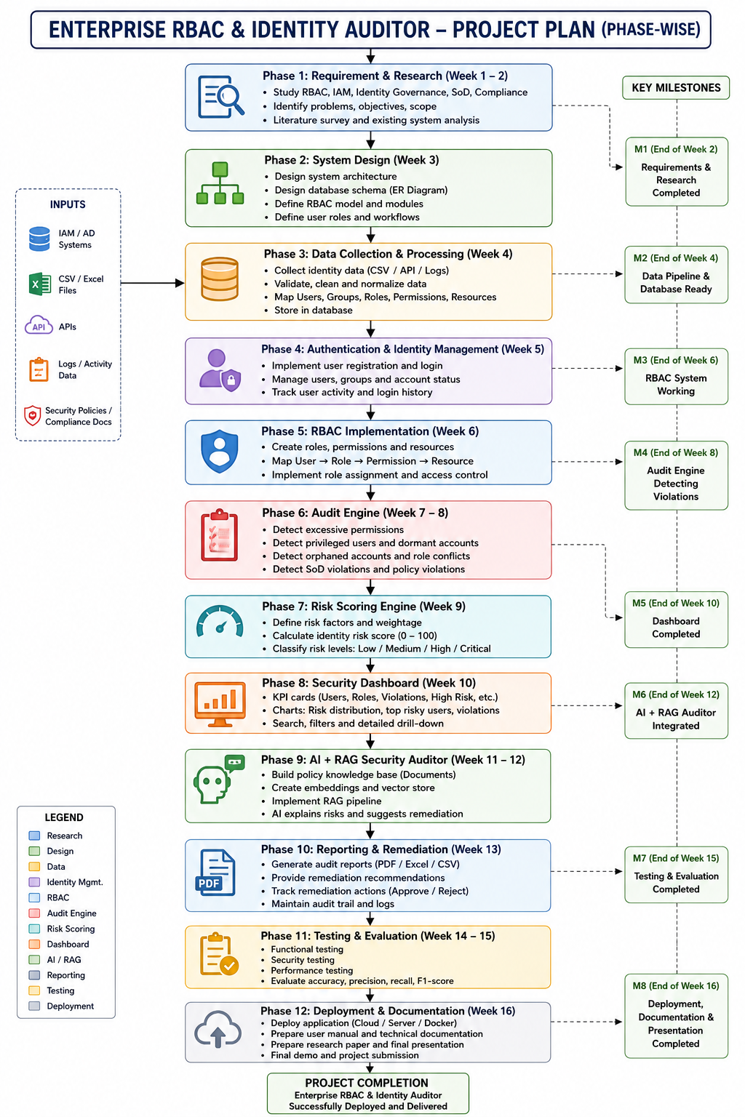
Project Plan

Slide 15
Conclusion
Summary: Develops an automated platform to manage and audit enterprise users, roles, and permissions.
Key Benefit: Detects excessive privileges, privilege creep, orphan accounts, and access-policy violations.
Innovation: Provides risk scoring and least-privilege recommendations through an interactive dashboard.
Next Steps: Implement the RBAC module, identity-auditing engine, risk analysis, dashboard, and evaluate the system using test datasets.
Expected Outcome: Improve enterprise access security, auditing efficiency, and compliance through continuous monitoring.

Slide 16
References
1. Currey, J., McKinstry, R., Dadgar, A., & Gritter, M. (2020). Informed Privilege-Complexity Trade-Offs in RBAC Configuration. SACMAT. DOI: 10.1145/3381991.3395597.
2. Abolfathi, M. et al. (2021). A Scalable Role Mining Approach for Large Organizations. ACM IWSPA. DOI: 10.1145/3445970.3451154.
3. Blundo, C. et al. (2022). Role Mining Heuristics for Permission-Role-Usage Cardinality Constraints. The Computer Journal. DOI: 10.1093/comjnl/bxaa186.
3. Blundo, C., & Cimato, S. (2023). Role Mining under User-Distribution Cardinality Constraint. JISA. DOI: 10.1016/j.jisa.2023.103611.
4. Improved minimal-noise role mining based on role interpretability. Computers & Security, 2023. DOI: 10.1016/j.cose.2023.103100.
5. Zhu, F. et al. (2024). MFC-RMA: Matrix Factorization and Constraints-Role Mining Algorithm. Symmetry. DOI: 10.3390/sym16081008.
6. Bi-objective Optimization in Role Mining. ACM Transactions on Privacy and Security, 2024. DOI: 10.1145/3697833.
7. Durdağ, O., & Coşkunçay, A. (2025). Reconfiguring Role-Based Access Control via Role Clustering. IEEE Access. DOI: 10.1109/ACCESS.2025.3563057.

Slide 17
THANK YOU

